Slide 1


CONSUMER GOODS
AD-HOC INSIGHTS

Slide 2
About AtliQ Hardware
Fiscal Year
September-2019 to August-2019
September-2020 to August-2020
FY 2020
FY 2021
Business Introduction
AtliQ Hardware is one of the leading computer hardware produce in india and well expanded in other countries too.
Business Plan
The management want to expand their Data Analytics team by adding several Junior Data Analyst.

Slide 3
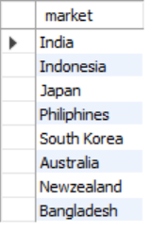
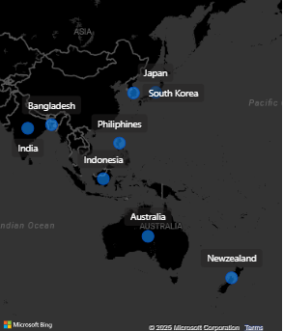
Questions
1. Provide the list of markets in which customer "Atliq Exclusive" operates its business in the APAC region.
Output
Insights
The customer "Atliq Exclusive" operates its business in 9 markets within the APAC region.

Slide 4

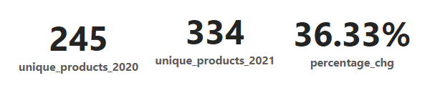
Questions
2. What is the percentage of unique product increase in 2021 vs. 2020? The final output contains these fields, unique_products_2020, unique_products_2021, percentage_chgn
which customer "Atliq Exclusive" operates its business in the APAC region.
Output

Slide 5
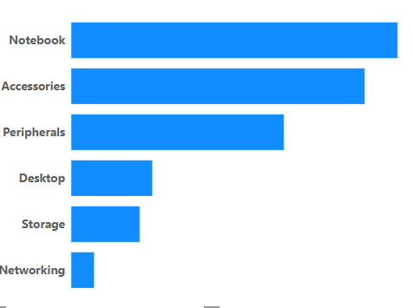
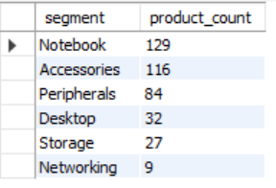
Questions
3. Provide a report with all the unique product counts for each segment and sort them in descending order of product counts. The final output contains 2 fields, segment product_count
Output

Slide 6
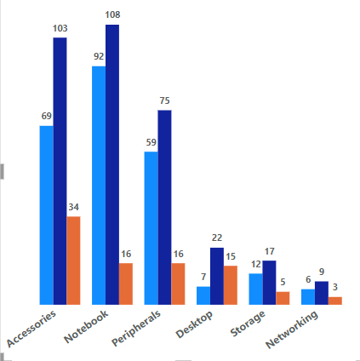
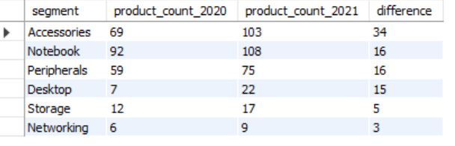
Questions
4. Follow-up: Which segment had the most increase in unique products in 2021 vs 2020? The final output contains these fields, segment ,product_count_2020, product_count_2021, difference
Output

Slide 7
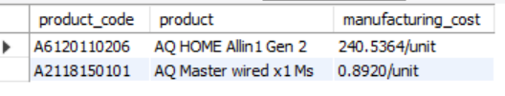

Questions
5. Get the products that have the highest and lowest manufacturing costs. The final output should contain these fields, product_code, product, manufacturing_cost
Output
Products with highest and lowest manufacturing cost
AQ Personal Desktop
AQ Wired Mouse

Slide 8
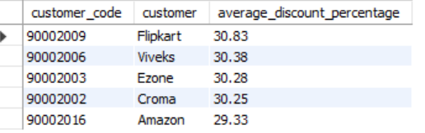
Questions
6. Generate a report which contains the top 5 customers who received an average high pre_invoice_discount_pct for the fiscal year 2021 and in the Indian market. The final output contains these fields, customer_code, customer, average_discount_percentage.
Output

Slide 9
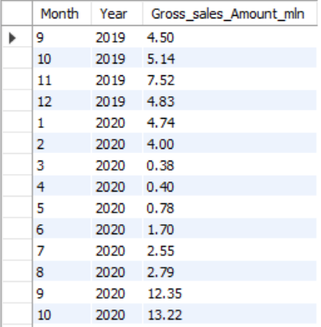
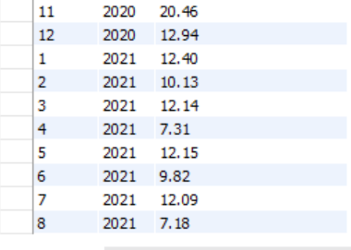
Questions
7. Get the complete report of the Gross sales amount for the customer “Atliq Exclusive” for each month. This analysis helps to get an idea of low and high-performing months and take strategic decisions. The final report contains these columns: Month, Year, Gross sales Amount.
Output

Slide 10
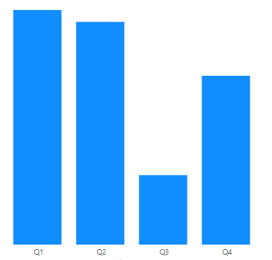
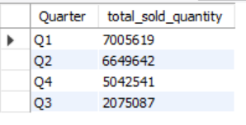
Questions
8. In which quarter of 2020, got the maximum total_sold_quantity? The final output contains these fields sorted by the total_sold_quantity, Quarter total_sold_quantity.
Output

Slide 11
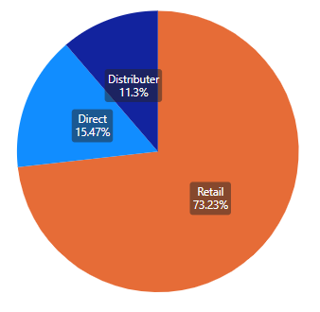
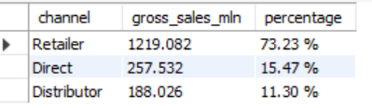
Questions
9. Which channel helped to bring more gross sales in the fiscal year 2021 and the percentage of contribution? The final output contains these fields, channel gross_sales_mln percentage
Output

Slide 12
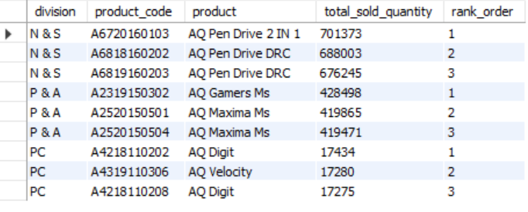
Questions
10. Get the Top 3 products in each division that have a high total_sold_quantity in the fiscal_year 2021? The final output contains these fields, division product_code.
Output

Slide 13
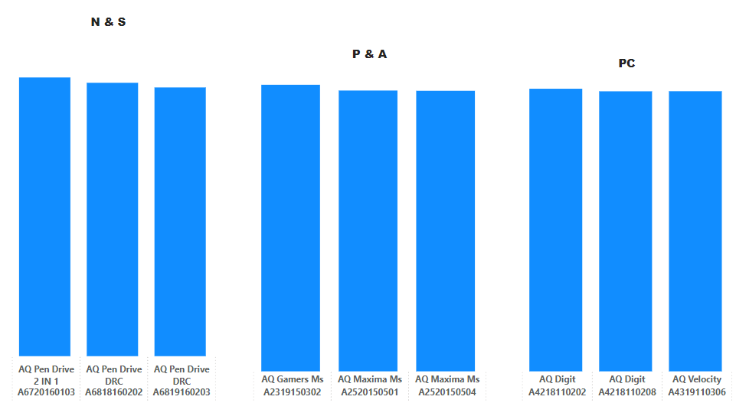
Insights

Slide 14
Thank You!

